Slide 1
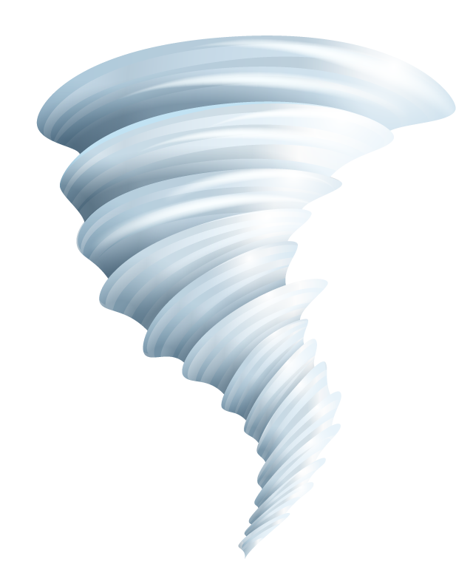

Predicting Tornado Injuries
Amanda Belden & Katherine Chan
Notes:
Kat

Slide 2
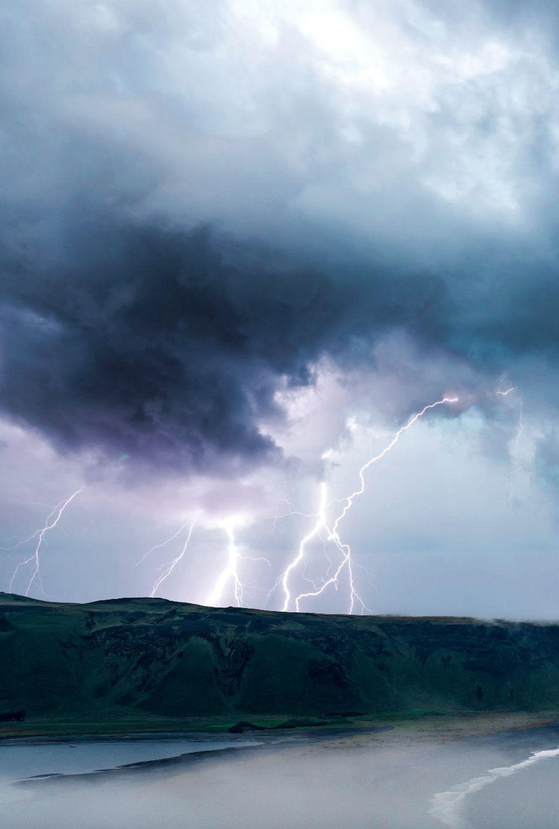
PRESENTATION OVERVIEW
1
2
3
4
5
Project & Data Introduction
Exploratory
Data Analysis
Prediction Modeling
& Results
Conclusions & Considerations
Application Demonstration
Notes:
Amanda

Slide 3
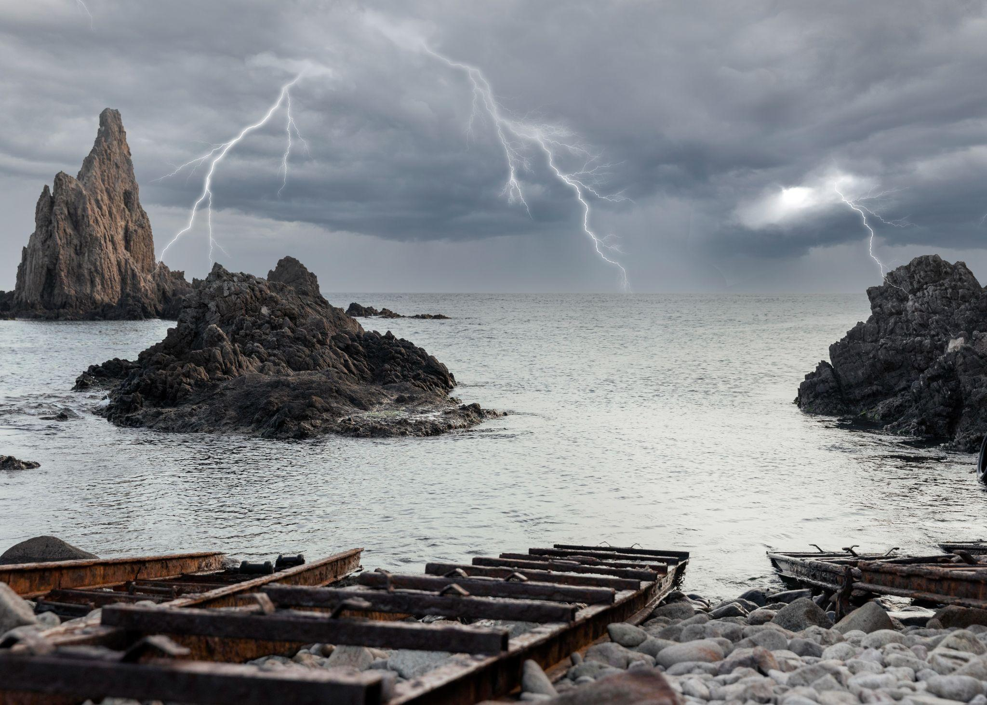
1
INTRODUCTION
Notes:
Kat

Slide 4
PROJECT MOTIVATION
In the past 20 years, the frequency of natural disasters has rapidly increased, primarily due to climate change.
It’s estimated that major natural disasters have caused:
1.2 million deaths
$3 trillion in economic losses
A planned response and proper justification for providing relief in a timely manner is of vital importance (EPRO of WHO)
Notes:
Kat: Within the past 20 years, the frequency of natural disasters has rapidly increased, primarily due to concerning developments in climate change [1]. In these past two decades, it is estimated that over 1.2 million people have been killed due to major natural disasters, accompanied by just under $3 trillion in economic losses [1].
As described by the Emergency Preparedness and Response Office of the World Health Organization, a planned response and proper justification for providing relief in a timely manner is of vital importance [2].

Slide 5
PROBLEM STATEMENT
Predicting amount of injuries caused by tornadoes in the US
Notes:
Amanda

Slide 6
DATA COLLECTION & DESCRIPTION
Publicly Available Storms Datasets
National Centers for Environmental Information (NCEI) in the National Oceanic and Atmospheric Administration (NOAA)
Information about storms & other significant weather phenomena in the US
From 1950 to 2023 recorded by NOAA's National Weather Service (NWS)*
We downloaded the datasets from the NCEI website
* we used years 2018, 2021, 2022, and 2023 as the other years had accessibility issues
Notes:
Amanda: Documenting storms with “sufficient intensity to cause loss of life, injuries, significant property damage, and/or disruption to commerce” - Amanda

Slide 7
PREDICTORS OF INTEREST
TIME VARIABLES
Time, day, month & year of storm, time elapsed
State, county, region type (county, marine, public forecast), county warning area
LOCATION
REPORTING SOURCE
E.g media, trained spotter, law enforcement, etc
Estimated length & width of tornado
MEASUREMENTS
STORM MOVEMENT
Beginning & end latitude & longitude, distance travelled
Notes:
Kat: We had other variables such as damage to property, damage to crops, and tornado scale (which is based off damages) but didn’t feel that it would be fair to consider them. We wanted to think reasonably about what information would be available at the time that a storm was occuring

Slide 8
PREPROCESSING STEPS
01
02
03
Merging storm location & details files
Subsetting to only tornados
Pooling multiple years
04
05
06
Calculating elapsed time & distance travelled
Converting injuries to categories
Dropping duplicates & NAs
Notes:
Amanda

Slide 9
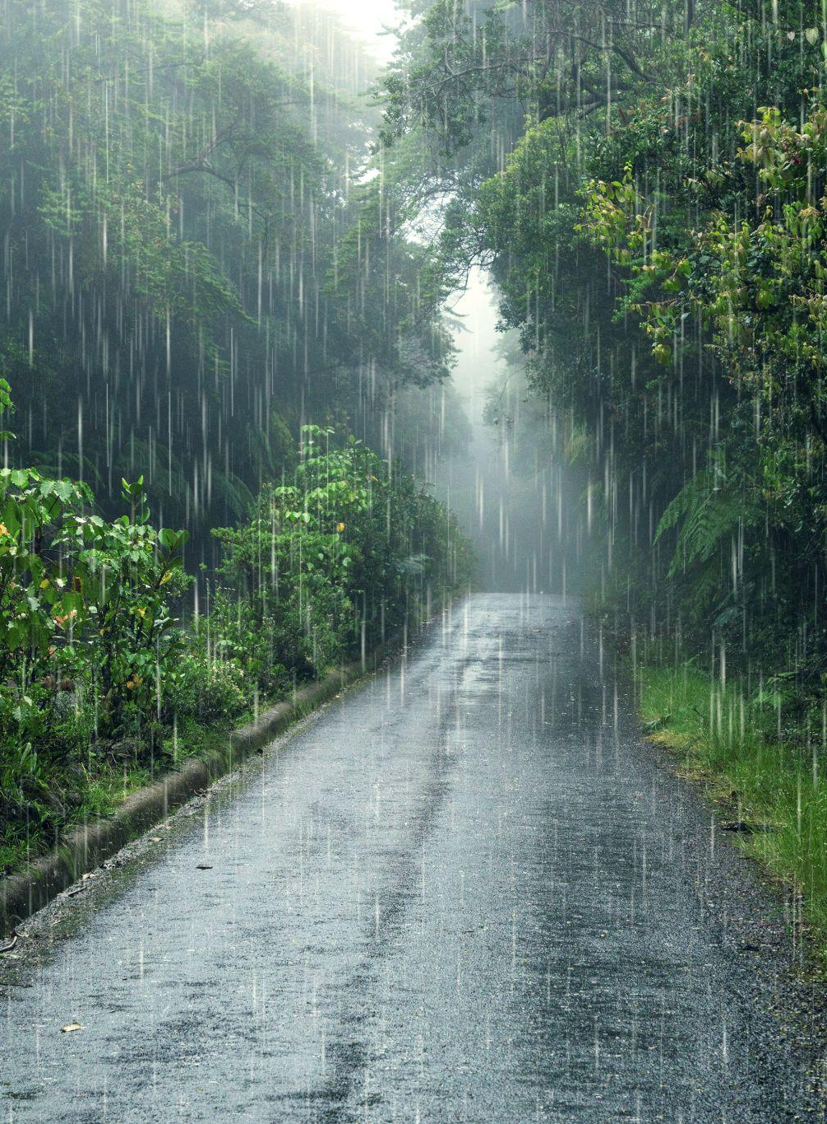
2
EXPLORATORY DATA ANALYSIS
Notes:
Kat

Slide 10
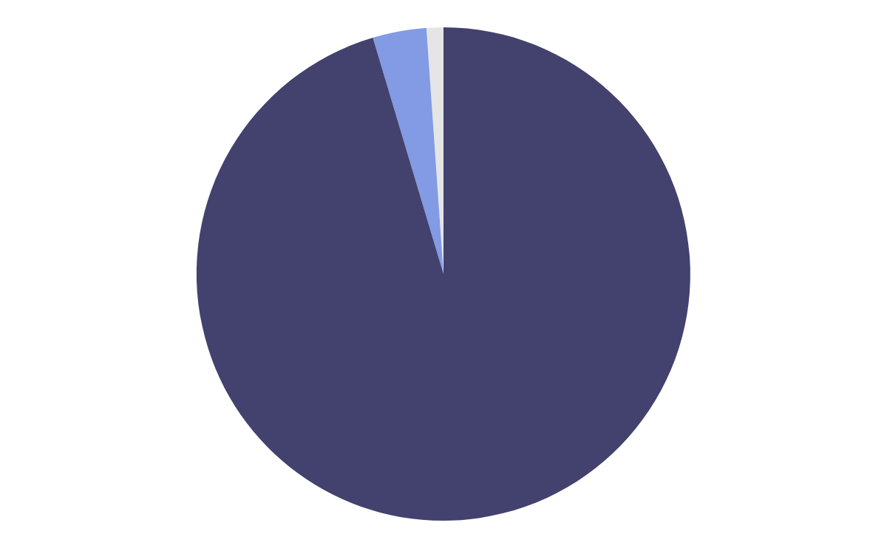
DISTRIBUTION OF INJURIES CLASSES
3797
No Injuries (95.38%)
140
Few Injuries (3.52%)
44
Many Injuries (1.11%)
No Injuries: 0 injuries, Few Injuries: 1-5 injuries, Many Injuries: 6+ injuries
Notes:
Kat

Slide 11
DATA AVERAGES BY INJURY CLASS
 | Tor Length | Tor Width | Time | Lat | Long
No Injuries | 2.66 | 160.07 | 4.83 | 37.28 | -91.59
Few Injuries | 7.37 | 442.93 | 10.60 | 34.35 | -88.34
Many Injuries | 11.48 | 673.31 | 15.81 | 35.46 | -90.46
Notes:
Kat

Slide 12
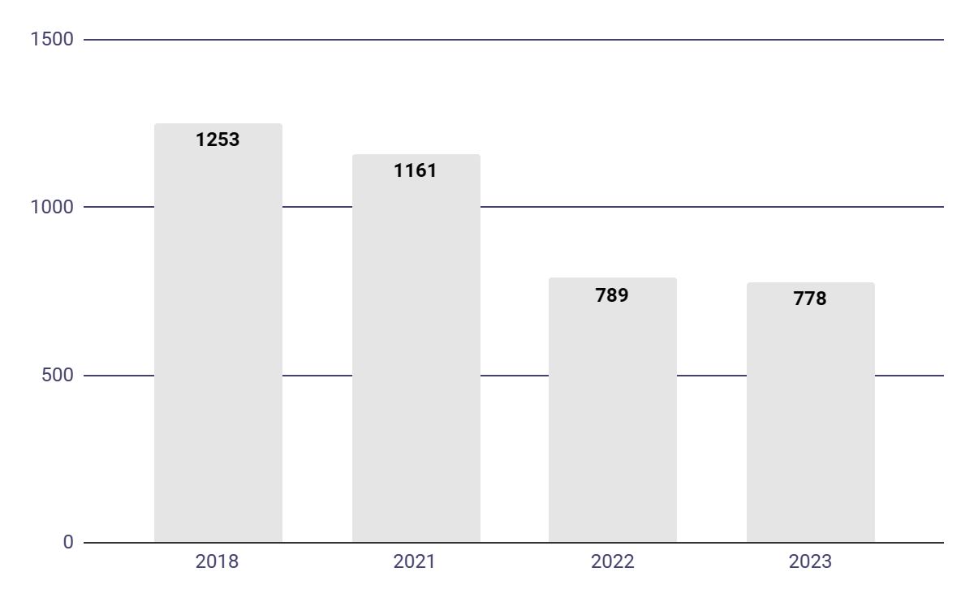
TORNADOES BY YEAR
 | 2023 | 2022 | 2021 | 2018
No Injuries | 734 | 744 | 1111 | 1208
Few Injuries | 35 | 30 | 38 | 37
Many Injuries | 9 | 15 | 12 | 8
Notes:
Amanda

Slide 13
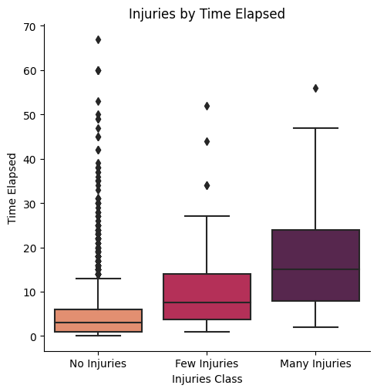
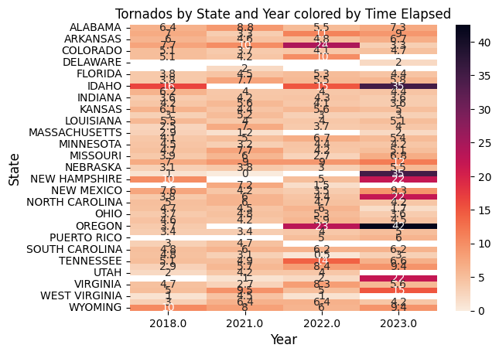
INJURIES by TIME ELAPSED
YEAR and STATE by TIME ELAPSED
Notes:
Amanda

Slide 14
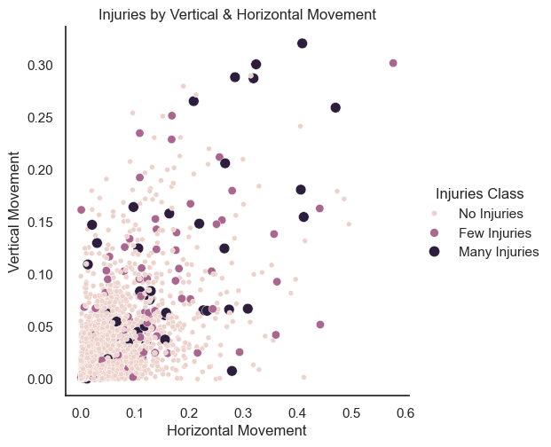
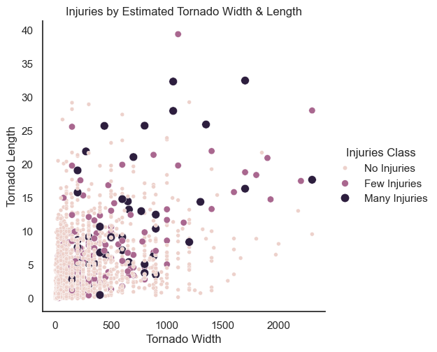
TORNADO MOVEMENT
TORNADO SIZE
Notes:
Kat

Slide 15
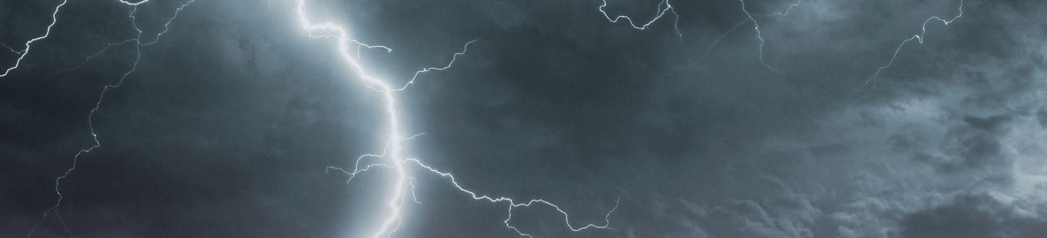
3
MODEL BUILDING & RESULTS
Notes:
Amanda

Slide 16
MODELING OVERVIEW
CLASSIFICATION
STRATIFIED K-FOLD
HYPERPARAMETER TUNING
Imbalance classes
3 Fold Cross Validation
Iterative tuning process
Notes:
Amanda

Slide 17
MODELS
DECISION TREE
XGBOOST
Tuning
Max depth: 5
Min samples leaf: 5
Min samples split: 34
Tuning
Max depth: 9
Min child weight: 2
N estimators: 7
Gamma: 1
Learning Rate: 1 (default)
Subsample: 0.95
Colsample by tree: 0.74
Notes:
Kat

Slide 18
CROSS VALIDATED RESULTS
 | Macro F1 | Macro Precision | Macro Recall | Accuracy
Decision Tree | 0.325 | 0.318 | 0.331 | 0.947
XGBoost | 0.430 | 0.537 | 0.401 | 0.950
Notes:
AManda

Slide 19
COMPARING MACRO PRECISION
53.7%
31.8%
XGBOOST
DECISION TREE
Notes:
Kat: Precision - indicates how well the model correctly predicts the class of interest (for multiclass: this is calculated for each class and then averaged)

Slide 20
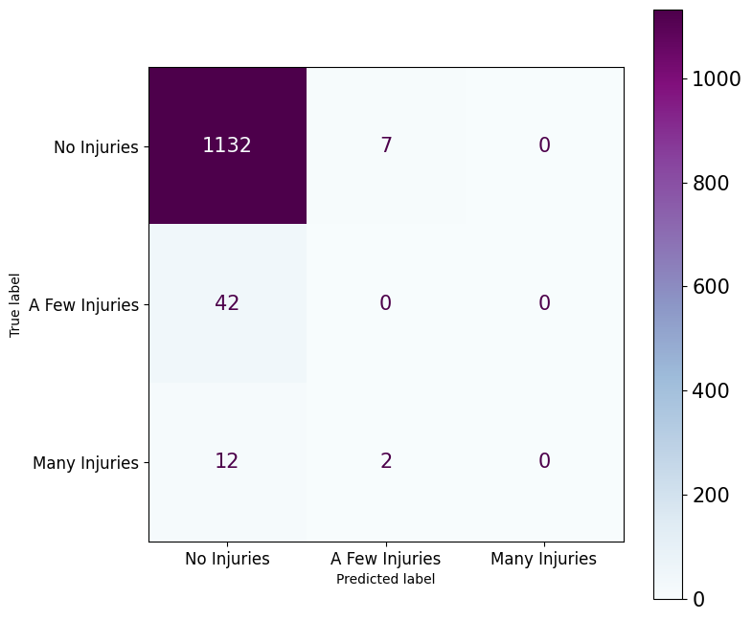
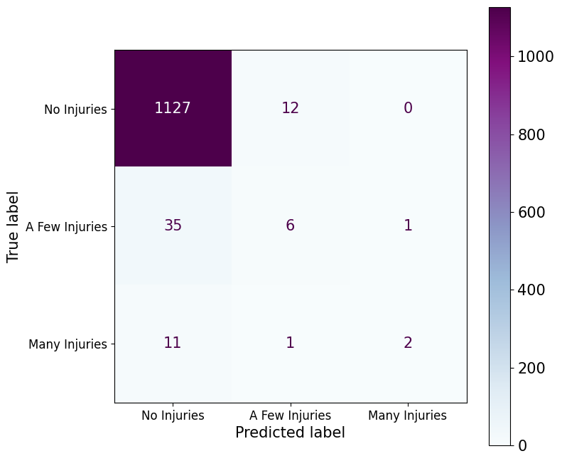
CONFUSION MATRIX
Decision Tree
XGBoost
Notes:
Amanda

Slide 21
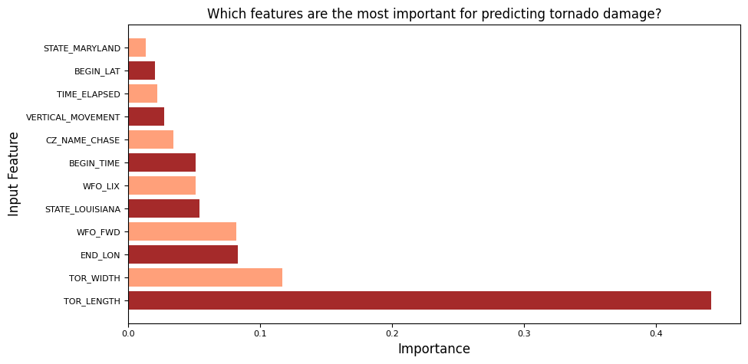
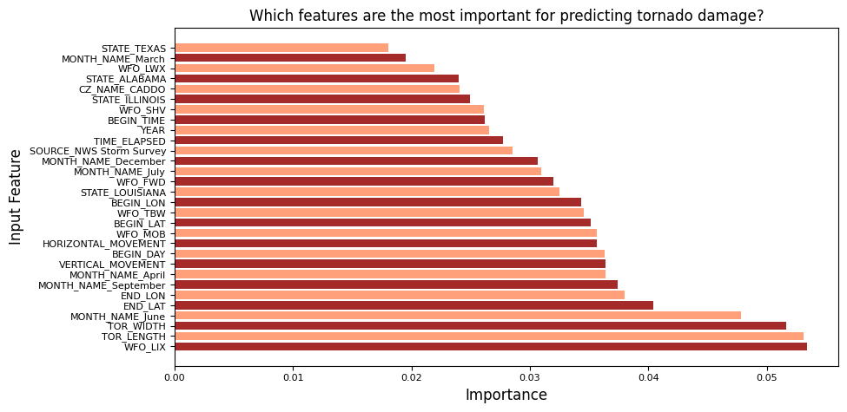
FEATURE IMPORTANCE PLOTS
Decision Tree
XGBoost
Notes:
Kat

Slide 22
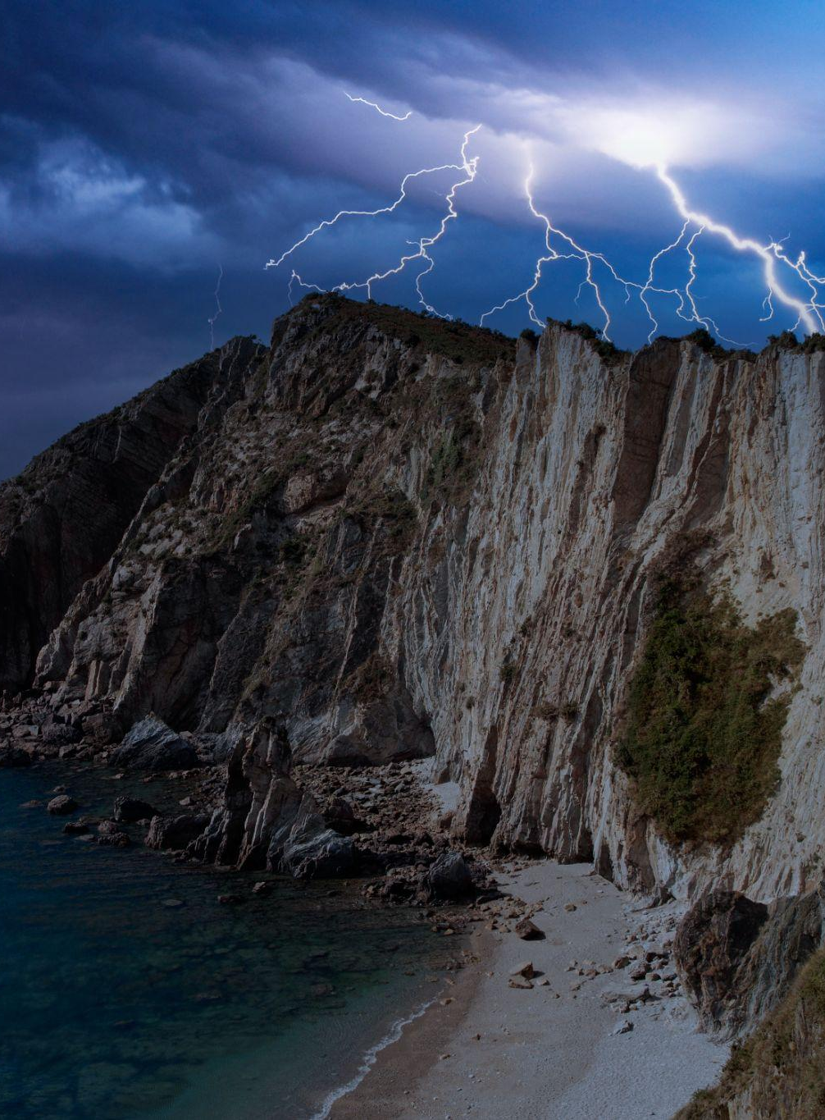
4
CONCLUSIONS & CONSIDERATIONS
Notes:
Amanda

Slide 23
Ethical Considerations, Limitations &
Future Extensions
Ethical Considerations
It’s possible for the model to predict no injuries for a tornado that may have few or many injuries, potentially misinforming people about their safety
Future Extensions
Pull in more years of data
Extend to look at fatalities
Analyze other storm types
Analyze with more location predictors
Limitations
Very little data for few and many injuries, potentially leading to the model under-classifying them
Notes:
Amanda

Slide 24
CONCLUSION
We can better model injuries caused by tornadoes in the US with an XGBoost algorithm compare to a Decision Tree
Estimated tornado width and length are highly important predictors
Certain counties (LIX in LA and MI) and certain months (June, April) are also important predictors
Achieving high precision in predicting tornado-related injuries can help emergency response and government relief to be adequately provided in a timely manner
Notes:
Kat

Slide 25
THANK YOU
Notes:
Kat

Slide 26
REFERENCES
https://e360.yale.edu/digest/extreme-weather-events-have-increased-significantly-in-the-last-20-years
https://onlinelibrary.wiley.com/doi/10.1111/j.1467-7717.1992.tb00378.x
https://www.ncdc.noaa.gov/stormevents/
https://www.ncei.noaa.gov/pub/data/swdi/stormevents/csvfiles/Storm-Data-Bulk-csv-Format.pdf

Slide 27
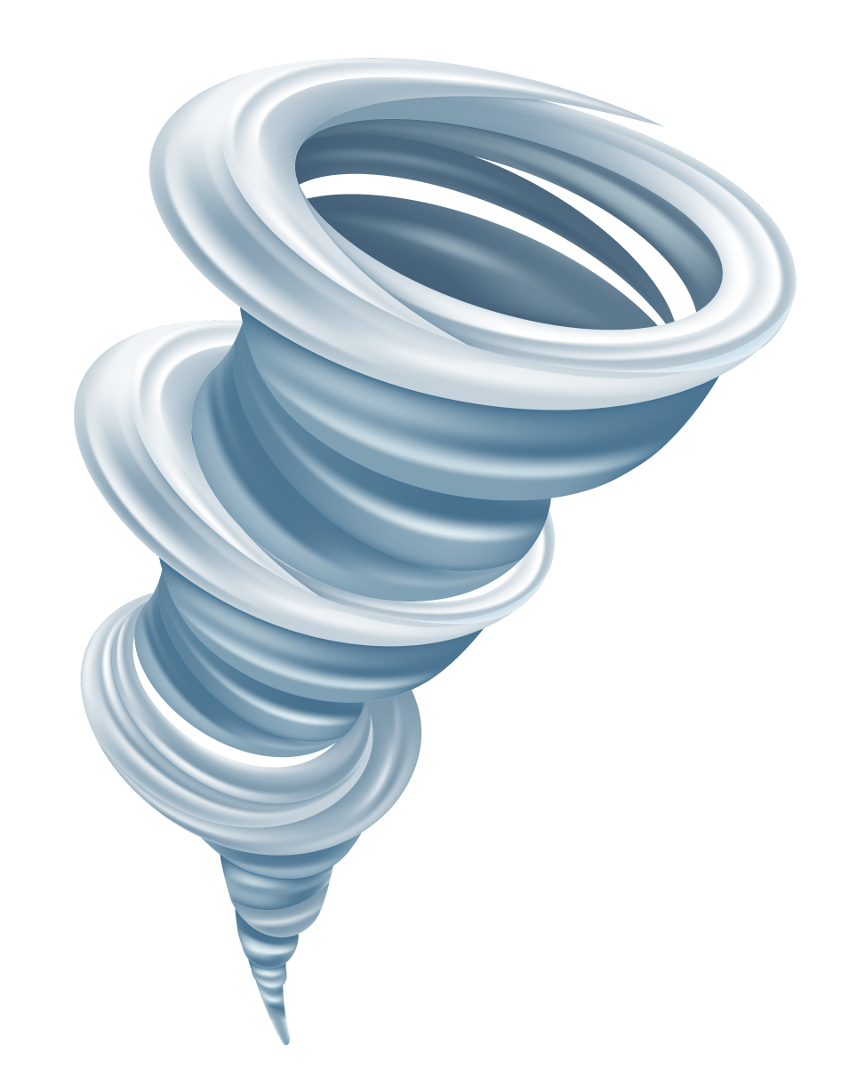
NOW ONTO THE APP DEMO!
Notes:
Amanda

